Slide 1
ModSim Project 3
Michaela Fox and Isabelle Rodriguez

Slide 2
How Infective does a Disease Need to be for Masks to be Ineffective?
This information is beneficial to health officials responsible for spreading information, and the general public who would want to know what is effective at preventing the spread of a disease.

Slide 3
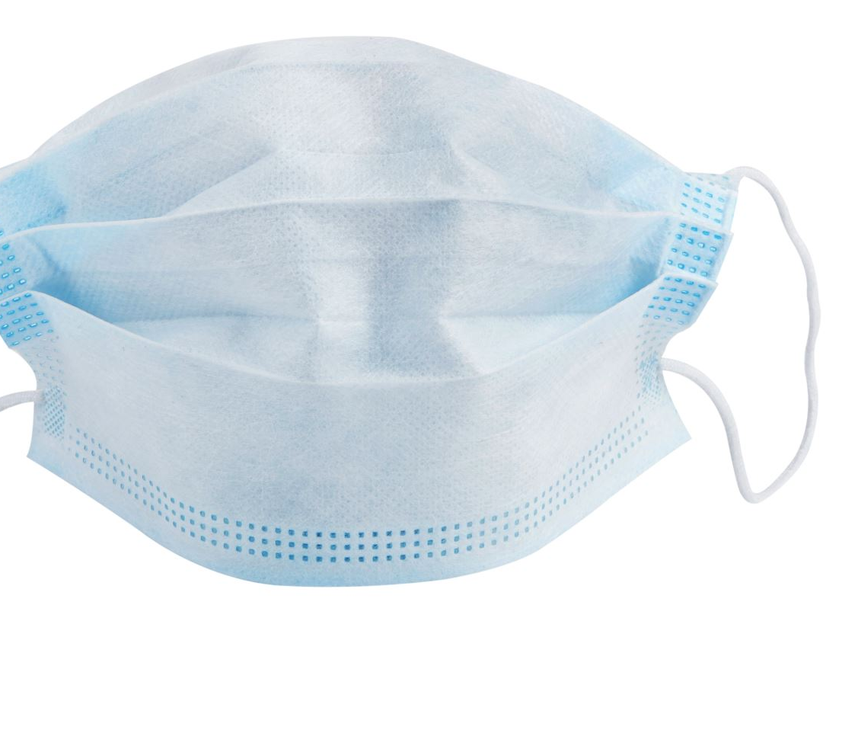
Important Information from our Research
Cloth Masks – 56% lower odds
Surgical Masks – 66% lower odds
N95/KN95 Masks – 83% lower odds
70% of the population wears a mask
36% of people wear a cloth face mask
29% of people wear KN95 masks
33% of people wear surgical masks

Slide 4
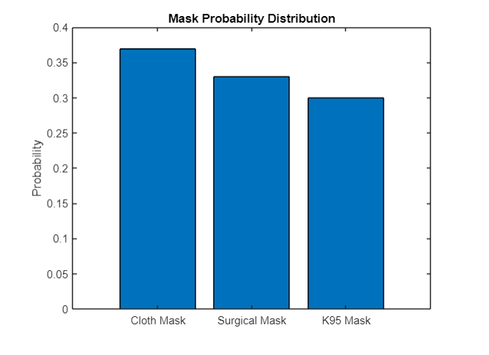

Slide 5
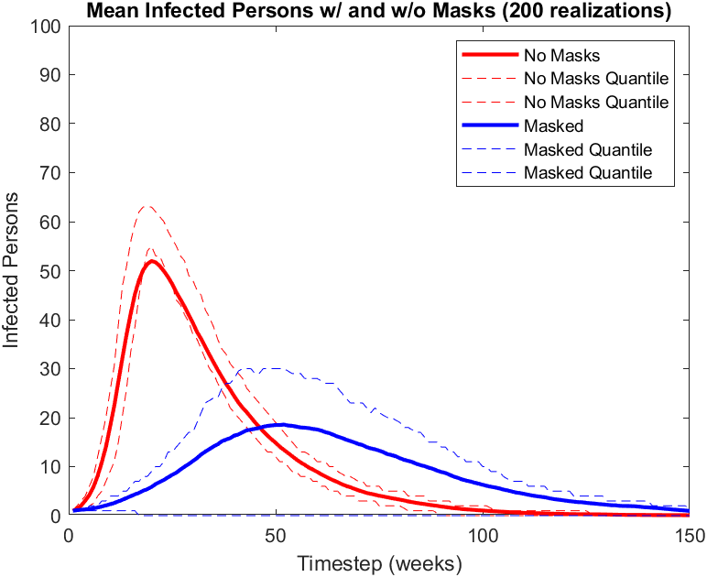

Slide 6
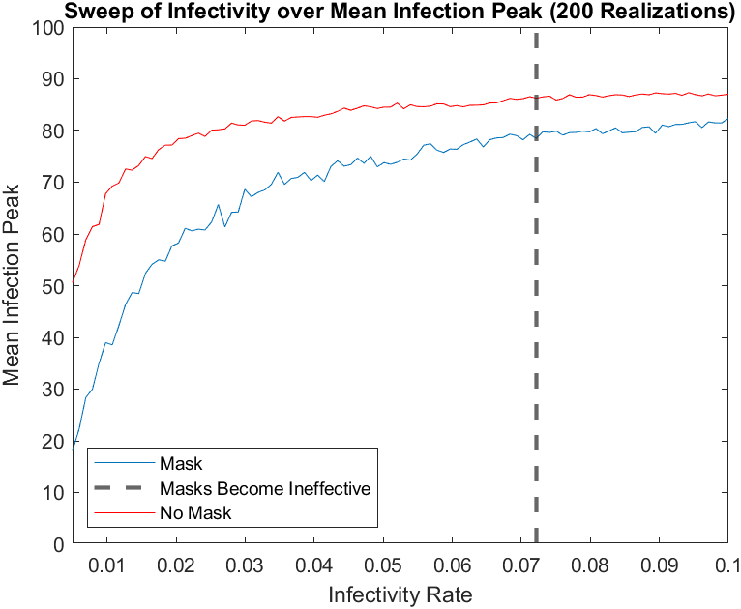

Slide 7

Interpretation
Masks become infective at an infection rate of about 0.072
- At this point, public health officials will want to encourage other protective measures--along with masks--against the disease

